Slide 1
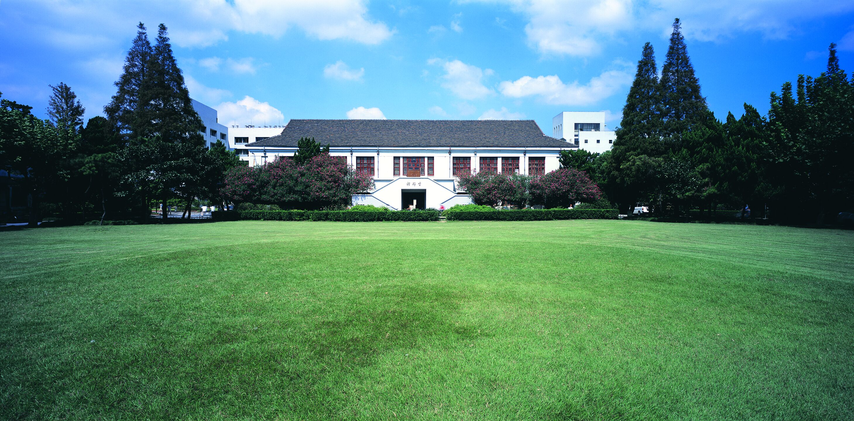
智能视频监控技术
闻超 18210860035

Slide 2
Pixel2Mesh: Generating 3D Mesh Models from Single RGB Images

Slide 3
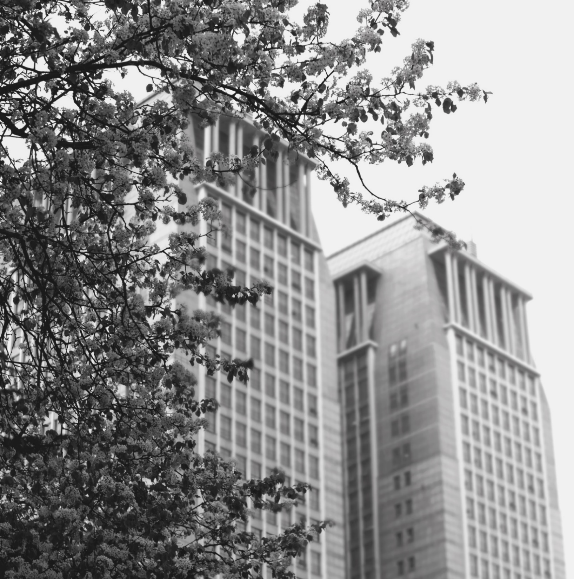
Introduction
1

Slide 4
Introduction of Pixel2Mesh
Introduction of the model
What is Pixel2Mesh?
Why Pixel2Mesh?

Slide 5
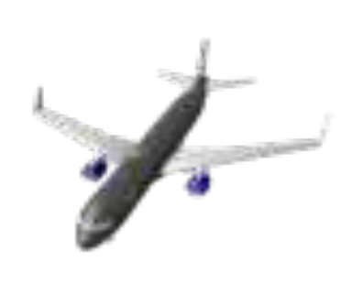
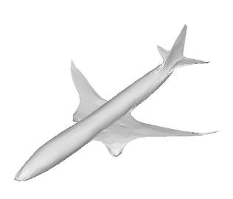
What is Pixel2Mesh?
Introduction of the model
Pixel2Mesh is an end-to-end deep learning architecture that produces a 3D shape in triangular mesh from a single color image
Wang N, Zhang Y, Li Z, et al. Pixel2Mesh: Generating 3D Mesh Models from Single RGB Images[J]

Slide 6
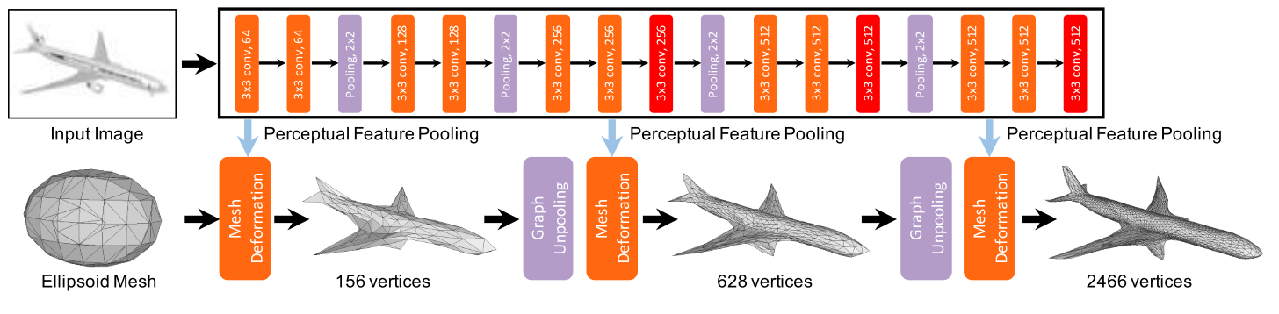
What is Pixel2Mesh?
Introduction of the model
Full Model Architecture
Wang N, Zhang Y, Li Z, et al. Pixel2Mesh: Generating 3D Mesh Models from Single RGB Images[J]

Slide 7
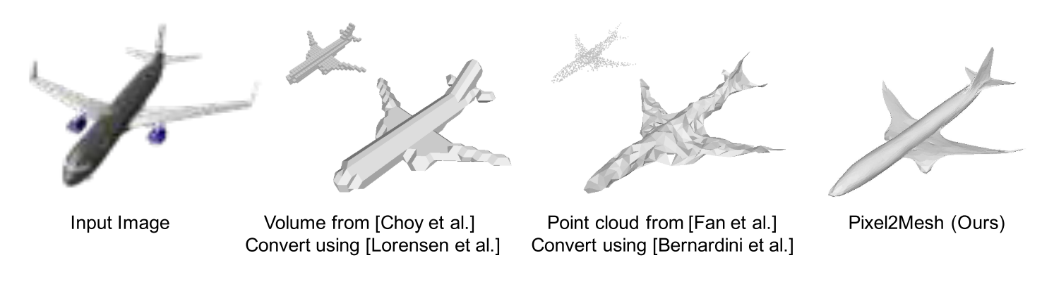
Why Pixel2Mesh?
Introduction of the model
The representations of 3D shape:
point cloud
voxel
mesh
However, both representations lose important surface details, and is non-trivial to reconstruct a surface model
Wang N, Zhang Y, Li Z, et al. Pixel2Mesh: Generating 3D Mesh Models from Single RGB Images[J]

Slide 8
Contributions of Pixel2Mesh?
Introduction of the model
The contributions of this paper are mainly in three aspects.
First, we propose a novel end-to-end neural network architecture that generates a 3D mesh model from a single RGB image.
Second, we design a projection layer which incorporates perceptual image features into the 3D geometry represented by GCN.
Third, our network predict 3D geometry in a coarse to fine fashion, which is more reliable and easy to learn.
Wang N, Zhang Y, Li Z, et al. Pixel2Mesh: Generating 3D Mesh Models from Single RGB Images[J]

Slide 9
Method
2

Slide 10
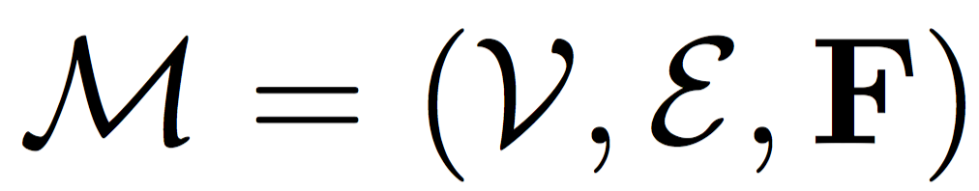
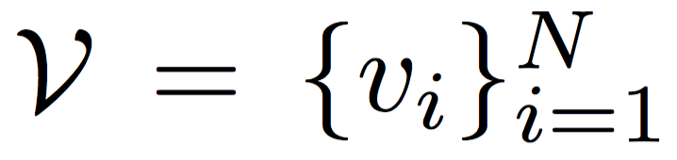
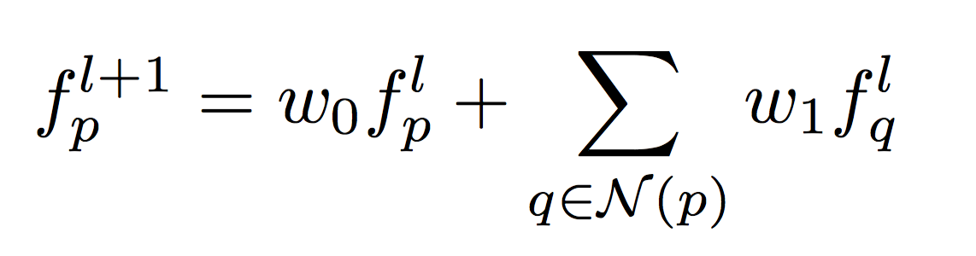
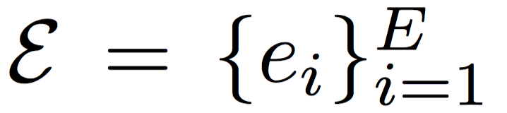
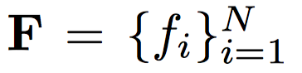
Preliminary: Graph-based Convolution
Technical details
We first provide some background about graph based convolution; more detailed introduction can be found in [1].
A 3D mesh is a collection of vertices, edges and faces.
feature vectors:
Running convolutions updates the features, which is equivalent as applying a deformation.
[1]:Bronstein, M.M., Bruna, J., LeCun, Y., Szlam, A., Vandergheynst, P.: Geometric deep learning: Going beyond euclidean data. IEEE Signal Process. Mag. 34(4), 18–42 (2017)
Wang N, Zhang Y, Li Z, et al. Pixel2Mesh: Generating 3D Mesh Models from Single RGB Images[J]

Slide 11
System Overview
Technical details
The model is an end-to-end deep learning framework that takes a single color image as input and produces a 3D mesh model in camera coordinate.
The image feature network is a 2D CNN.
The cascaded mesh deformation network is a graph-based convolution network (GCN).
The graph unpooling layers increase the number of vertices to increase the capacity of handling details.
Wang N, Zhang Y, Li Z, et al. Pixel2Mesh: Generating 3D Mesh Models from Single RGB Images[J]

Slide 12
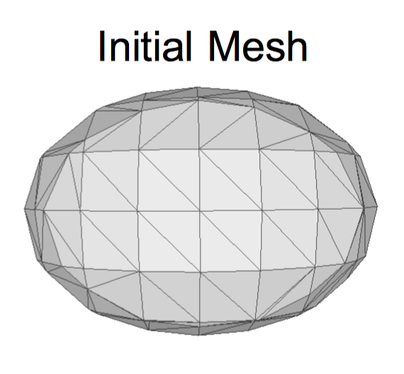
Initial ellipsoid
Technical details
The model does not require any prior knowledge of the 3D shape, and always deform from an initial ellipsoid with average size placed at the common location in the camera coordinate.
The ellipsoid is centered at 0.8m in front of the camera with 0.2m, 0.2m, 0.4m as the radius of three axis. The mesh model is generated by implicit surface algorithm in Meshlab [2] and contains 156 vertices.
[2] Cignoni, P., Callieri, M., Corsini, M., Dellepiane, M., Ganovelli, F., Ranzuglia, G.: Meshlab: an open-source mesh processing tool. In: Eurographics Italian Chapter Conference (2008)
Wang N, Zhang Y, Li Z, et al. Pixel2Mesh: Generating 3D Mesh Models from Single RGB Images[J]

Slide 13
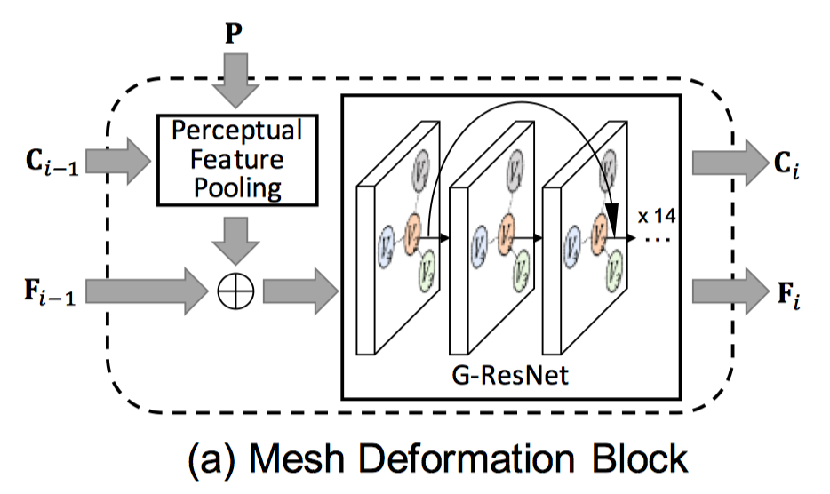

Mesh deformation block
Technical details
The vertex locations C_{i} are used to extract image features, which are then combined L with vertex features F_{i} and fed into G-ResNet[1]. means a concatenation of the features.
In order to generate 3D mesh model that is consistent with the object shown in the input image, the deformation block need to pool feature (P) from the input image.
[1]:Bronstein, M.M., Bruna, J., LeCun, Y., Szlam, A., Vandergheynst, P.: Geometric deep learning: Going beyond euclidean data. IEEE Signal Process. Mag. 34(4), 18–42 (2017)
Wang N, Zhang Y, Li Z, et al. Pixel2Mesh: Generating 3D Mesh Models from Single RGB Images[J]

Slide 14
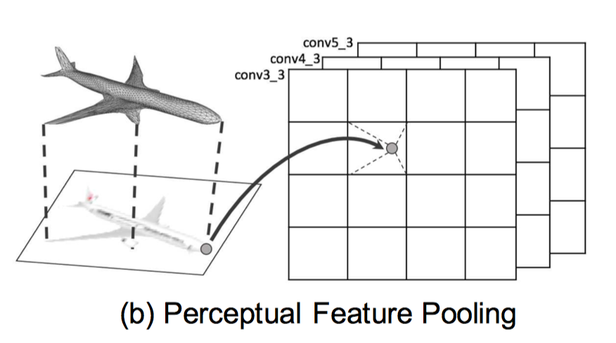
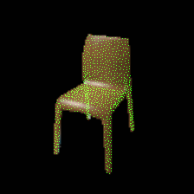
Perceptual feature pooling layer
Technical details
The 3D vertices are projected to the image plane using camera intrinsics, and perceptual feature is pooled from the 2D-CNN layers using bilinear interpolation.
The model use a VGG-16 architecture, in particular, we concatenate feature extracted from layer ‘conv3-3’, ‘conv4-3’, and ‘conv5-3’,
Wang N, Zhang Y, Li Z, et al. Pixel2Mesh: Generating 3D Mesh Models from Single RGB Images[J]

Slide 15
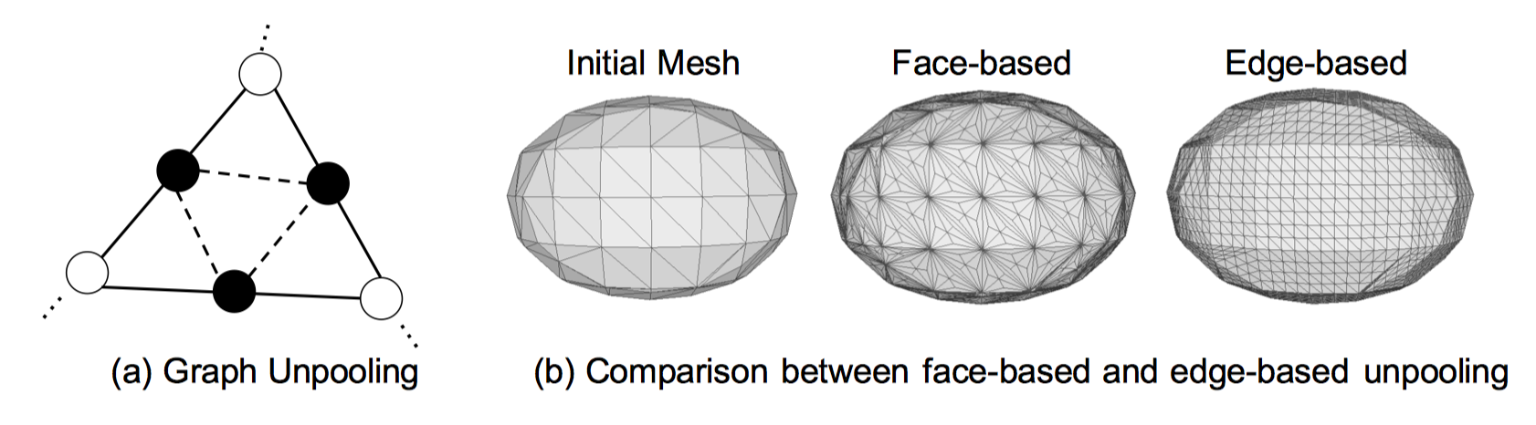
Graph unpooling layer
Technical details
Black vertices and dashed edges are added in the unpooling layer.
The face based unpooling leads to imbalanced vertex degrees, while the edge-based unpooling remains regular.
Wang N, Zhang Y, Li Z, et al. Pixel2Mesh: Generating 3D Mesh Models from Single RGB Images[J]

Slide 16
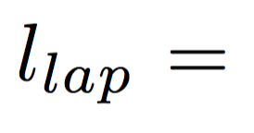
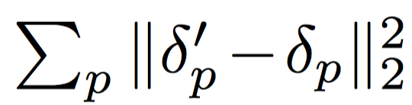
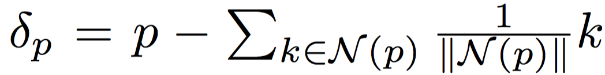
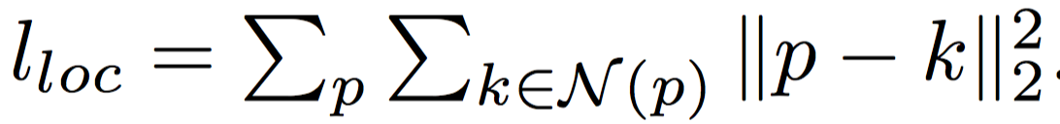
Losses
Technical details
Chamfer loss:
Normal loss:
Laplacian regularization:
Edge length regularization:
Wang N, Zhang Y, Li Z, et al. Pixel2Mesh: Generating 3D Mesh Models from Single RGB Images[J]

Slide 17
Experiments
3

Slide 18
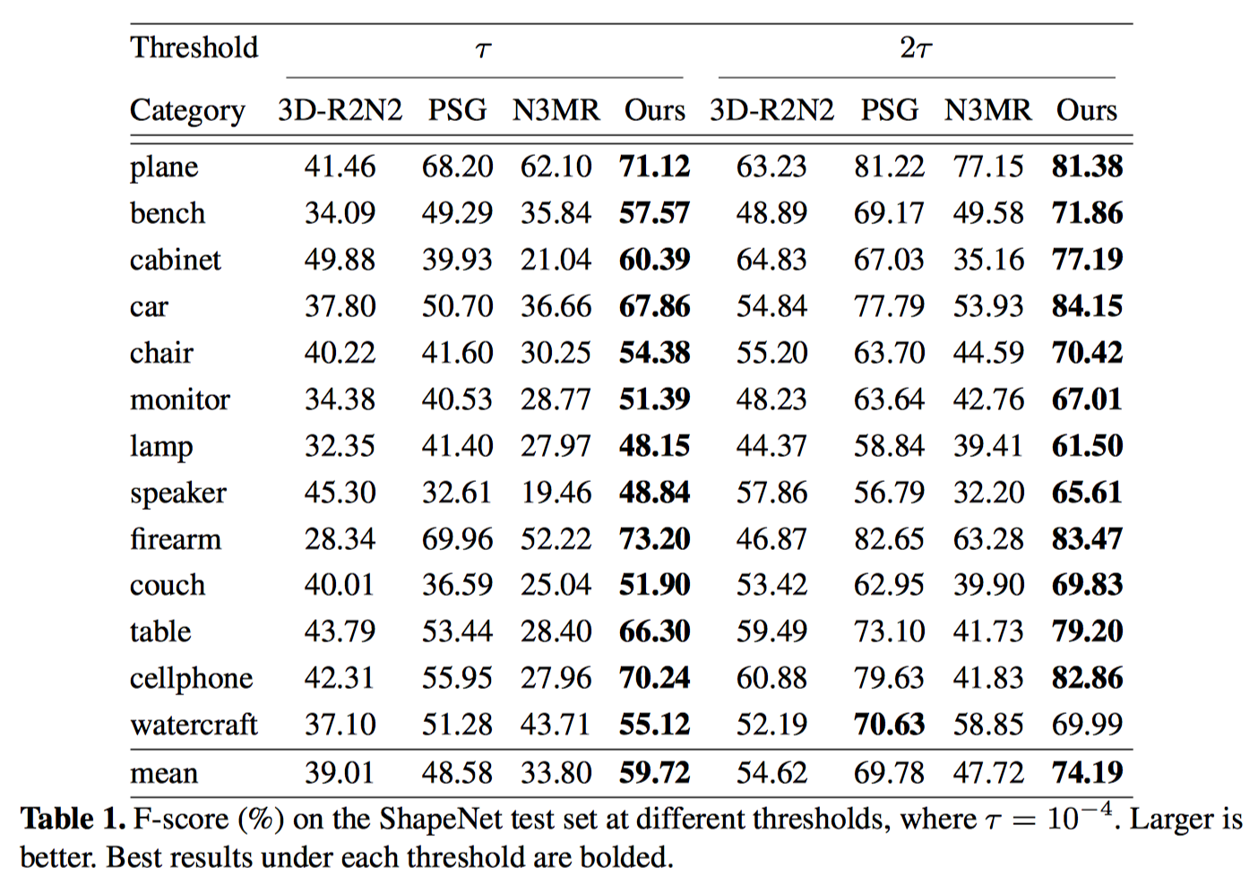
Quantitative results——F1 score
Experiments
Wang N, Zhang Y, Li Z, et al. Pixel2Mesh: Generating 3D Mesh Models from Single RGB Images[J]

Slide 19
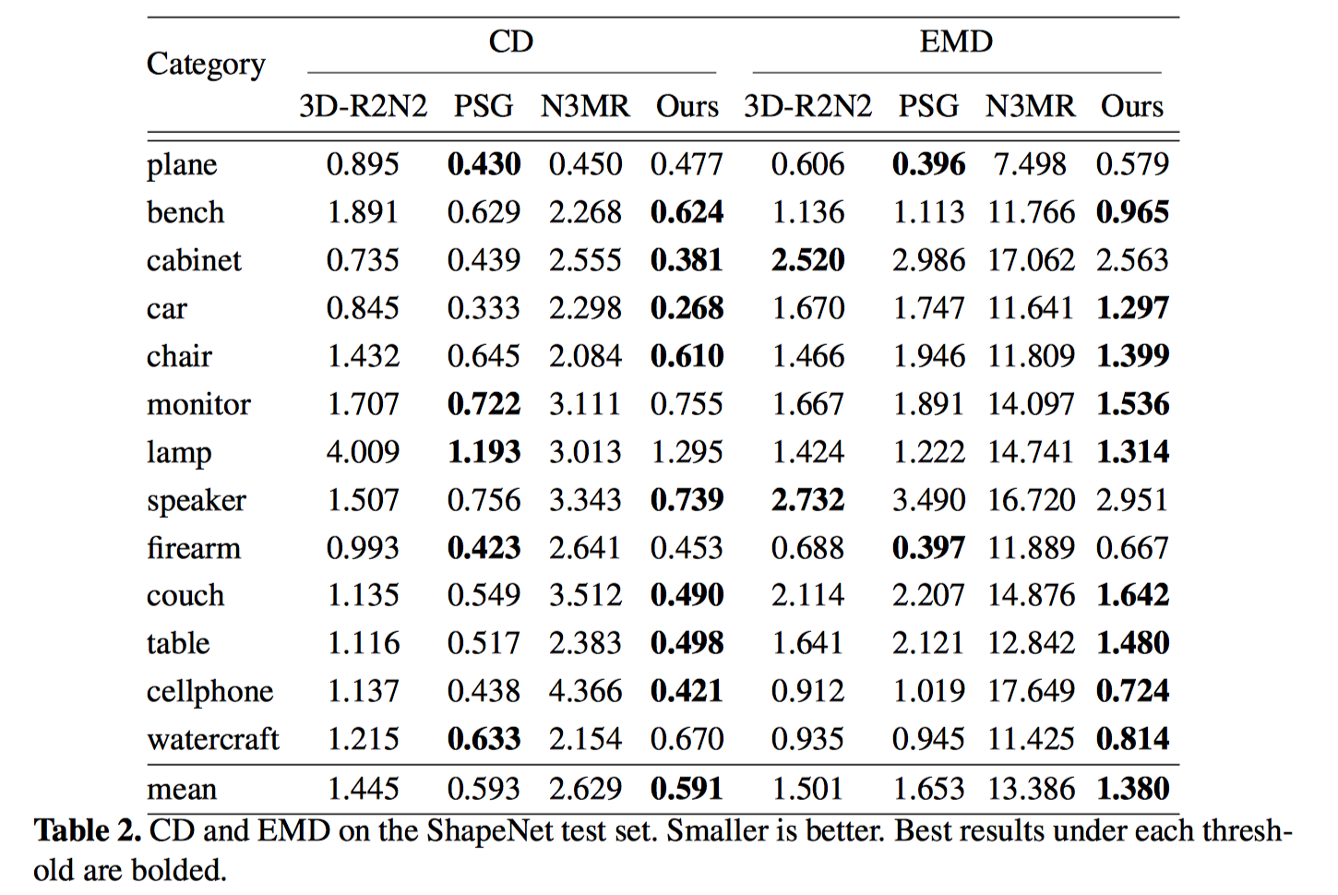
Quantitative results——CD and EMD
Experiments
Wang N, Zhang Y, Li Z, et al. Pixel2Mesh: Generating 3D Mesh Models from Single RGB Images[J]

Slide 20
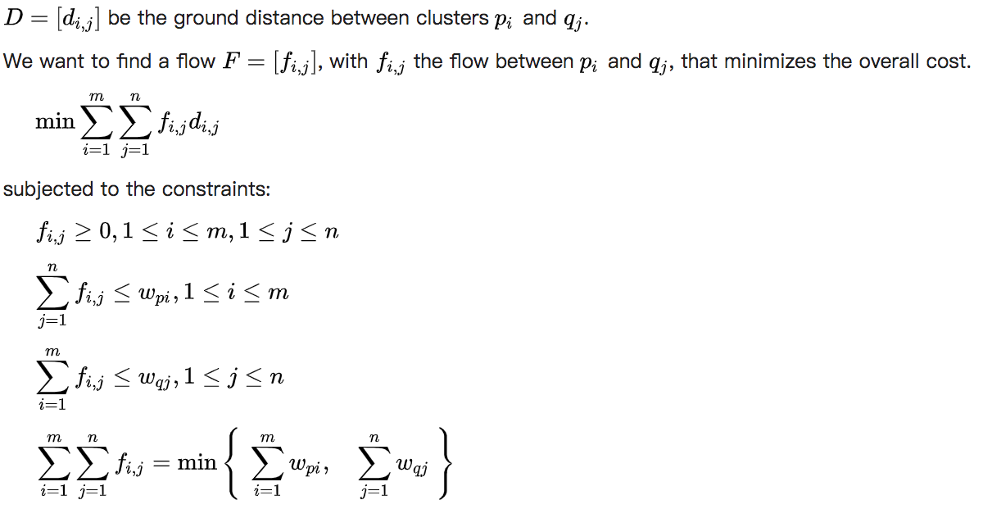
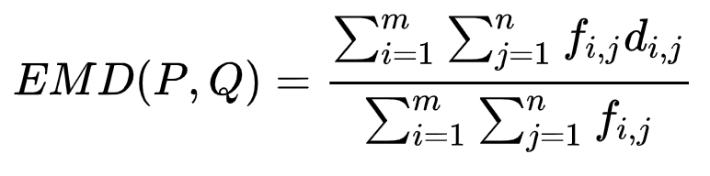
EMD
Experiments
In statistics, the earth mover's distance (EMD) is a measure of the distance between two probability distributions over a region D.
In mathematics, this is known as the Wasserstein metric.
Wang N, Zhang Y, Li Z, et al. Pixel2Mesh: Generating 3D Mesh Models from Single RGB Images[J]
Notes:
Earth Move翻译过来是搬土，指把P位置的m个坑的土，用最小的代价搬到Q位置的n个坑中，d_{ij}是pi到qj两个坑的距离，f_{ij}是从pi搬到qj的土量，则WORK工作量就是要最小化的目标。线性规划求解出f_{ij}后，再用f_{ij}对WORK作个归一化，就得到了EMD。

Slide 21
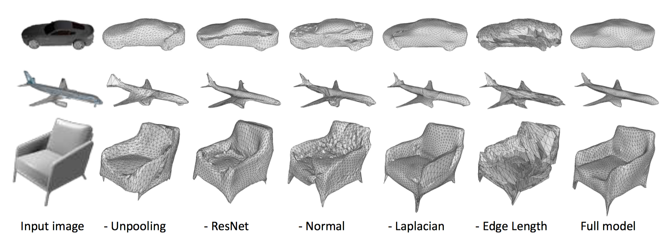
Qualitative results for ablation study
Technical details
Wang N, Zhang Y, Li Z, et al. Pixel2Mesh: Generating 3D Mesh Models from Single RGB Images[J]

Slide 22
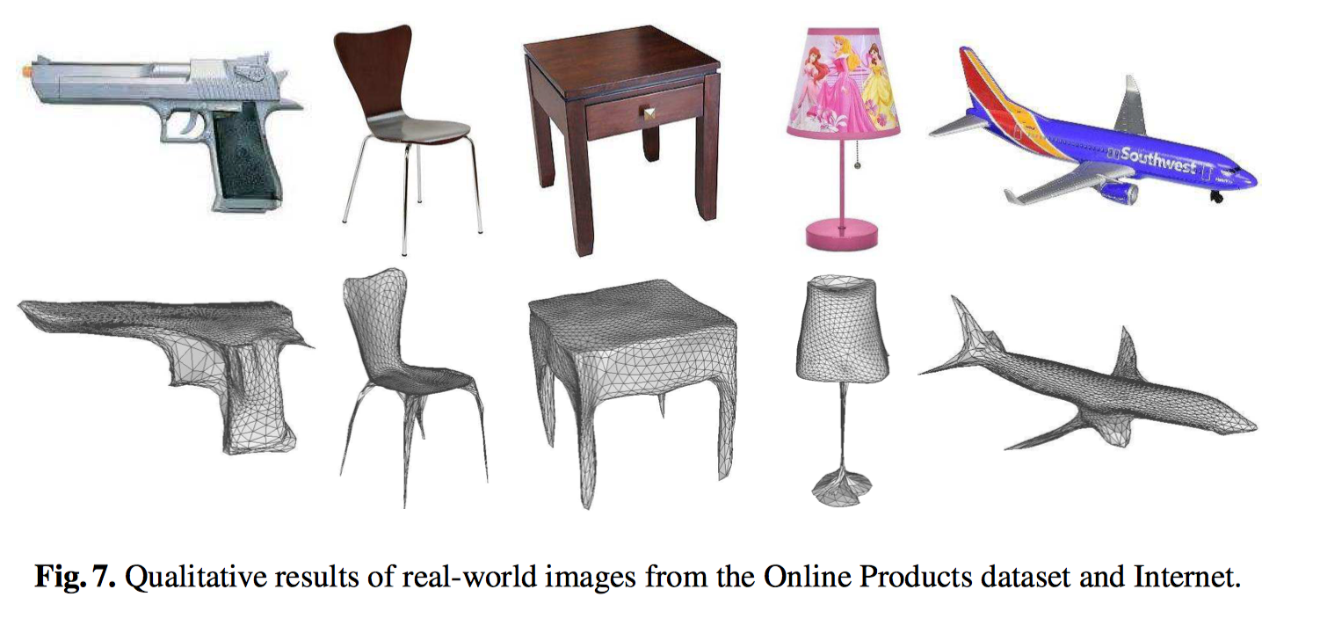
Reconstructing Real-World images
Technical details
Wang N, Zhang Y, Li Z, et al. Pixel2Mesh: Generating 3D Mesh Models from Single RGB Images[J]

Slide 23
Conclusion
4

Slide 24
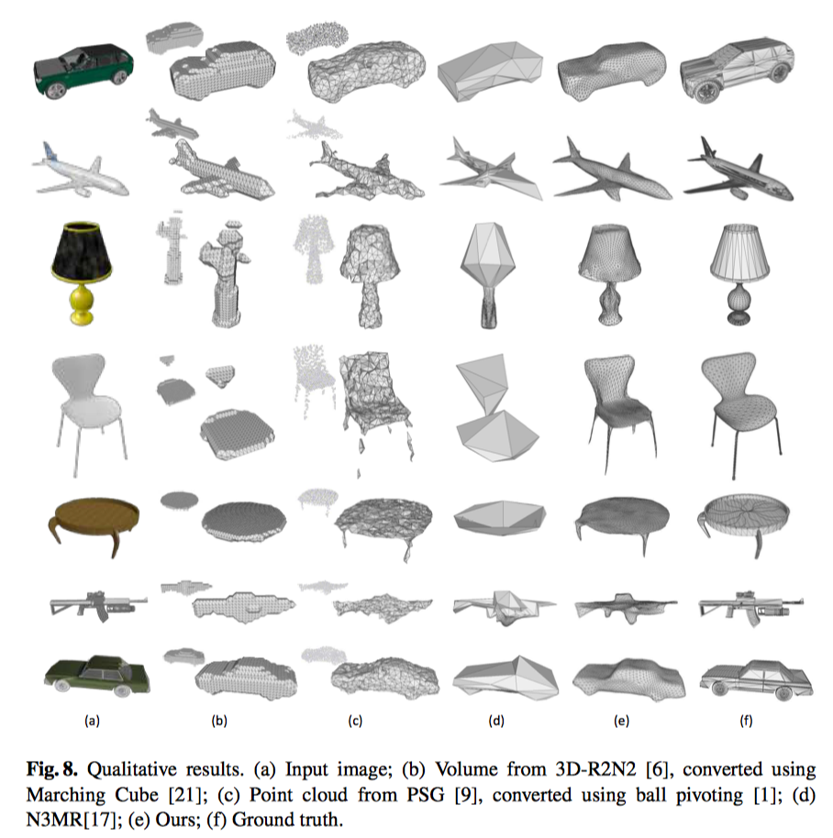
Conclusion
Conclusion
Our results are signiﬁcantly better than the previous state-of-the-art using other shape representations such as 3D volume or 3D point cloud.
Thus, we believe mesh representation is the next big thing in this direction, and we hope that the key components discovered in our work can support follow-up works that will further advance direct 3D mesh reconstruction from single images.
Wang N, Zhang Y, Li Z, et al. Pixel2Mesh: Generating 3D Mesh Models from Single RGB Images[J]

Slide 25
Conclusion
Conclusion
https://github.com/nywang16/Pixel2Mesh
Welcome to star!
Wang N, Zhang Y, Li Z, et al. Pixel2Mesh: Generating 3D Mesh Models from Single RGB Images[J]

Slide 26
THANKS

